Slide 1
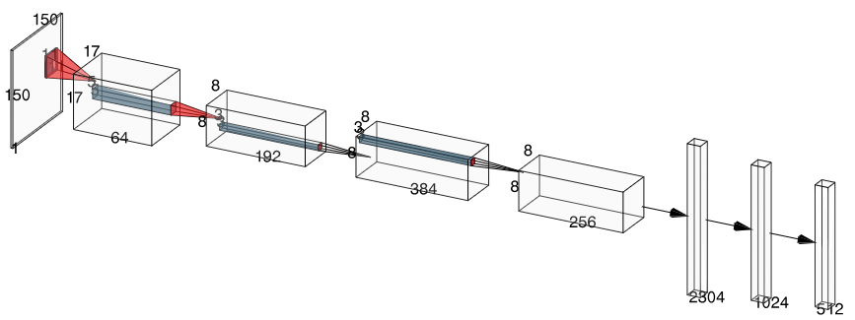
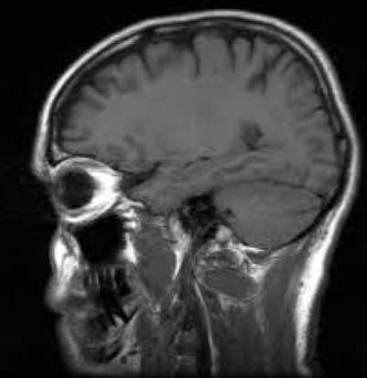
CNN BASE MODEL (basado en AlexNet)
CONV(2)
5 X 5
S = 1
P = 2
RELU
MAX POOL
CONV(4)
3 X 3
S = 1
P = 1
RELU
CONV(1)
11 X 11
S = 4
P = 2
RELU
MAX POOL
CONV(3)
3 X 3
S = 1
P = 1
RELU
CONV(5)
3 X 3
S = 1
P = 1
RELU
MAX POOL
Activación Softmax aplicada en inferencia (incluida en CrossEntropyLoss)

